Slide 1


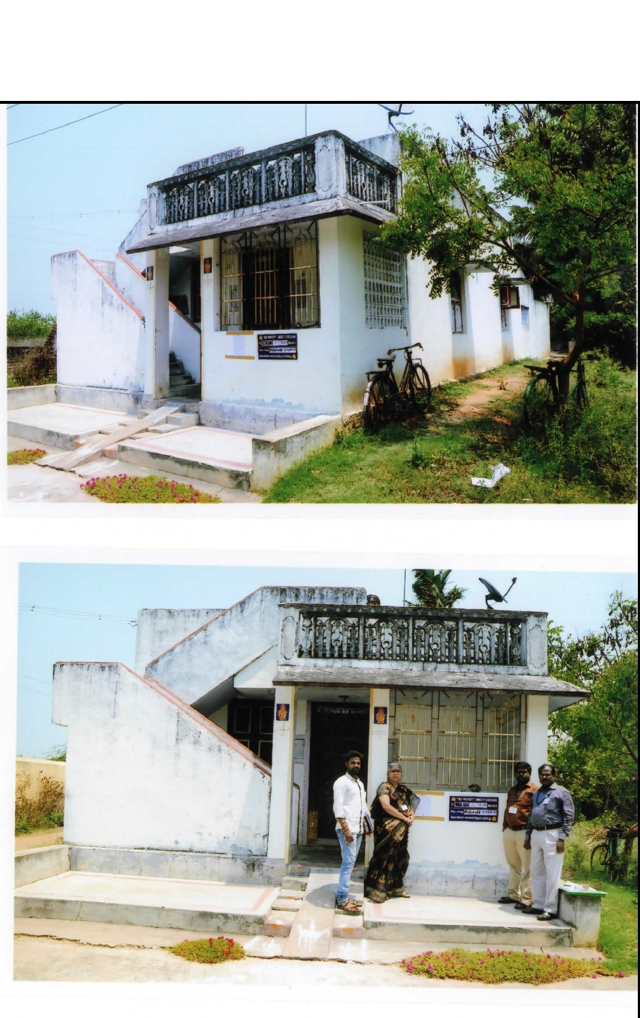
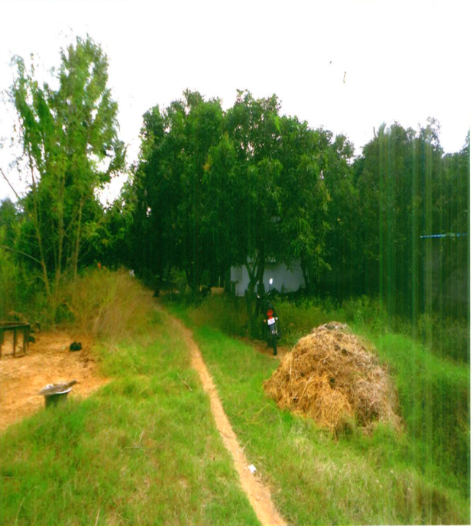
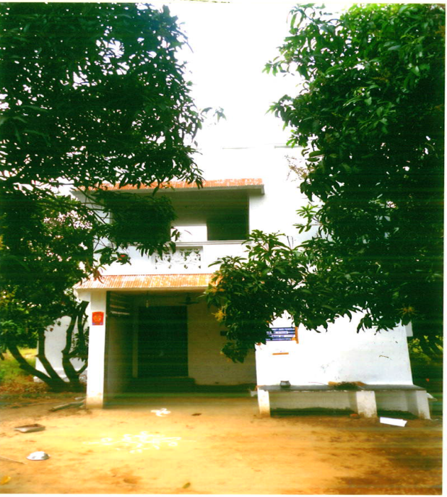
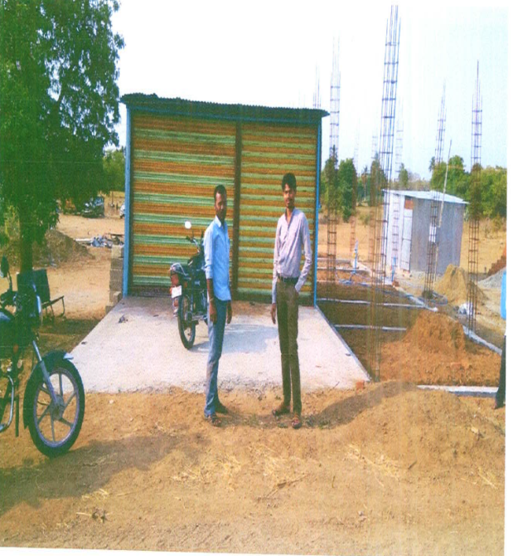
RESIDENTIAL BUILDING
RESB - 051
Location of Property | TIRUVANNAMALAI/MAZHAIYUR
Total area of land | 383 cents
Constructed area | Ground floor -964 Sqft/ First floor – 192 Sqft
Year of construction | 2013
Current market value | Rs. 27.64 Lacs

Slide 2
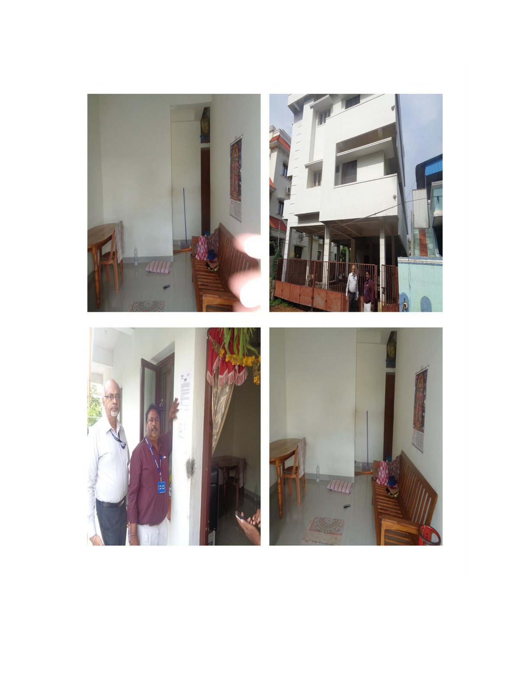
RESIDENTIAL FLAT
RESB - 052
Location of Property | POZHICHALUR,CHENNAI
Total area of land | 2907 sq.ft
Constructed area | 450 sq.ft(UDS),Flat no. B,1st Floor
Year of construction | 2015
Current market value | Rs. 29.61 Lacs

Slide 3
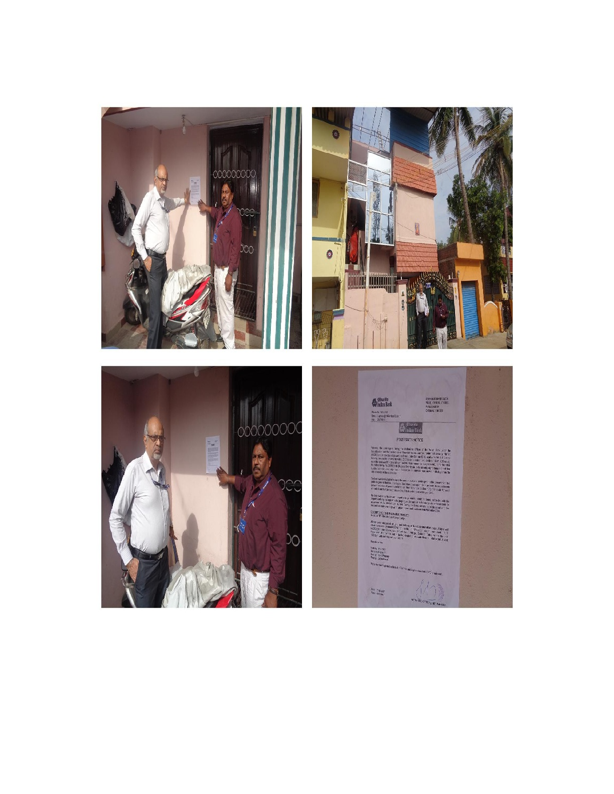
RESIDENTIAL BUILDING
RESB - 053
Location of Property | POZHICHALUR, CHENNAI
Total area of land | 1660 sq.ft
Constructed area | 1660 sq.ft(GF+FF+SF)
Year of construction | 2000(GF),2003(FF+SF)
Current market value | Rs. 68.79 Lacs

Slide 4
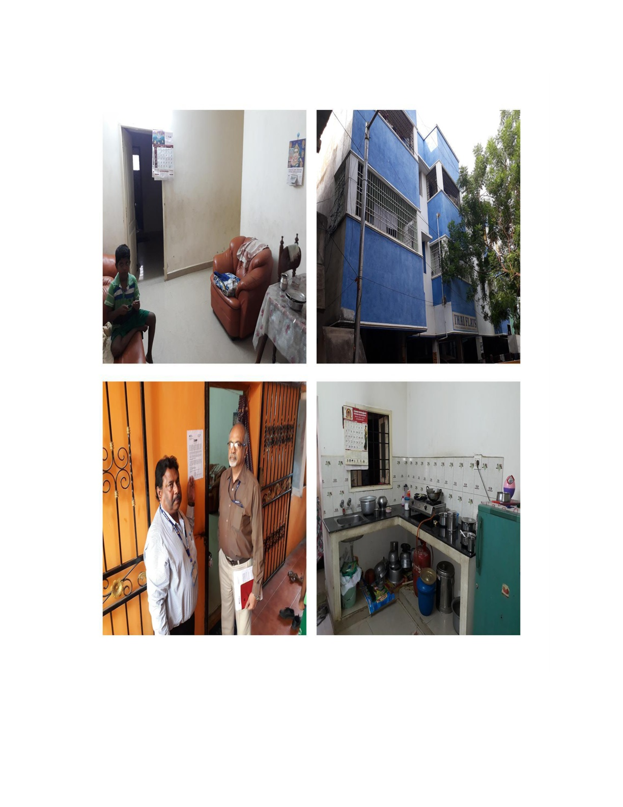
RESIDENTIAL FLAT
RESB - 054
Location of Property | DEVRAJNAGAR,MAMBALAM, CHENNAI
Total area of land | 7709 sq.ft(undivided share)
Constructed area | 930 sq.ft (2nd Floor)
Year of construction | 2010
Current market value | Rs. 50.22 Lacs

Slide 5
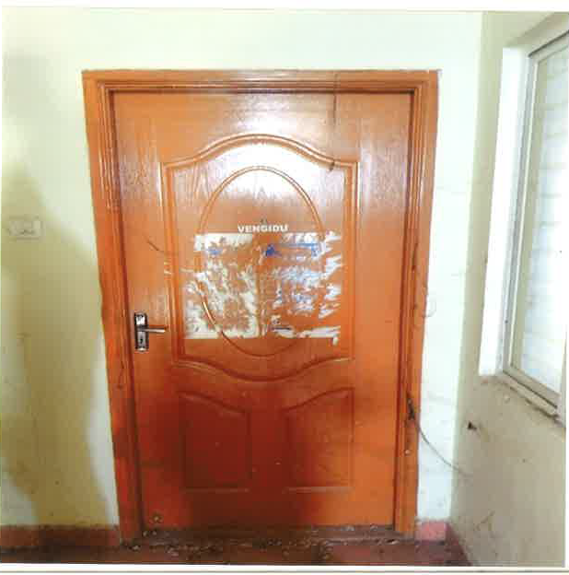
RESIDENTIAL FLAT
RESB - 055
Location of Property | GUDUVANCHERY,KANCHEEPURAM
Total area of land | 3577 sq.ft
Constructed area | 814 sq.ft (2nd Floor)
Year of construction | 2013
Current market value | Rs. 11.40 Lacs

Slide 6
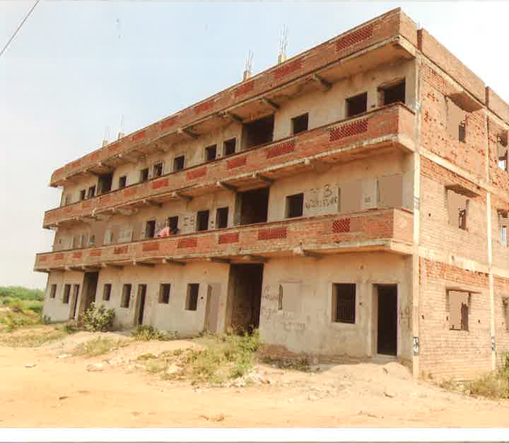
RESIDENTIAL FLAT
RESB - 056
Location of Property | MYLAPORE,THIRUVALLUR
Total area of land | 1750 sq.ft
Constructed area | 716 sq.ft (Ground Floor)
Year of construction | NA
Current market value | Rs. 05.73 Lacs

Slide 7
RESIDENTIAL FLAT
RESB - 057
Location of Property | MYLAPORE,THIRUVALLUR
Total area of land | 1750 sq.ft
Constructed area | 726 sq.ft (2nd Floor)
Year of construction | NA
Current market value | Rs. 05.80 Lacs

Slide 8
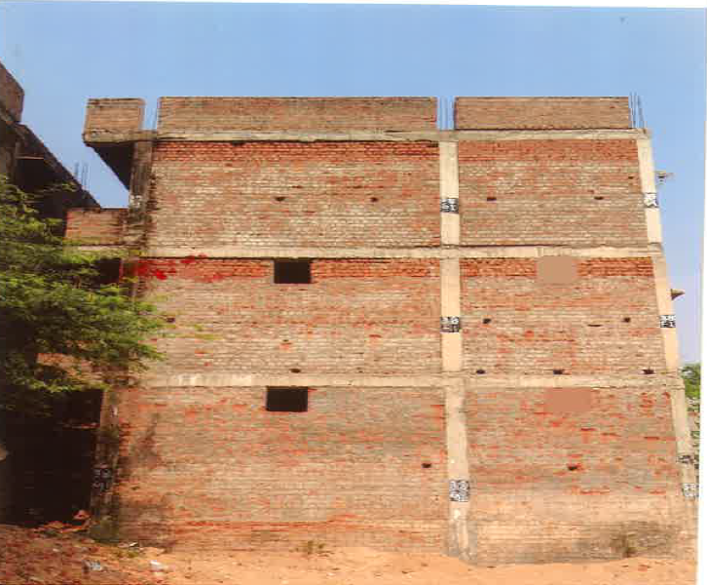
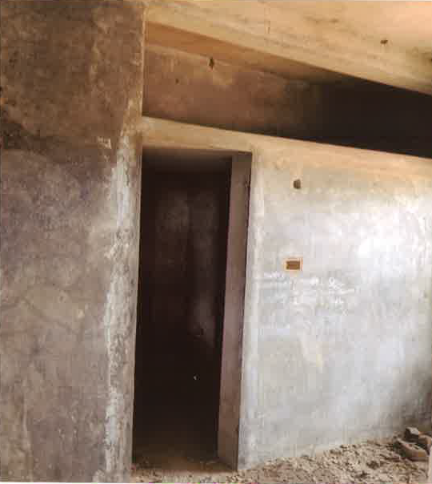
RESIDENTIAL FLAT
RESB - 058
Location of Property | MYLAPORE,THIRUVALLUR
Total area of land | 1750 sq.ft
Constructed area | 726 sq.ft ( S1, 2nd Floor)
Year of construction | NA
Current market value | Rs. 05.80 Lacs

Slide 9
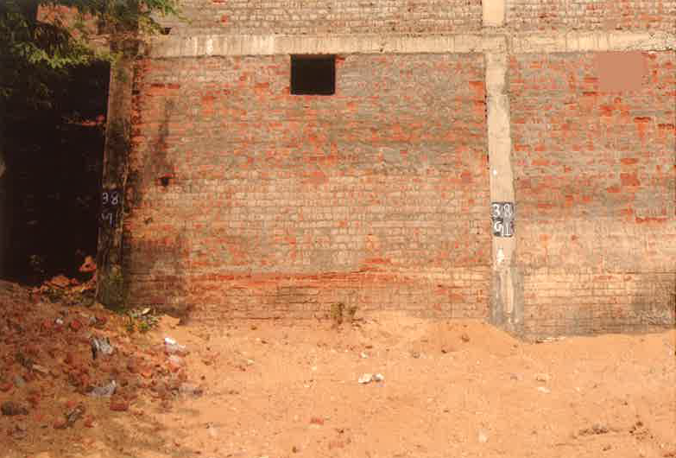
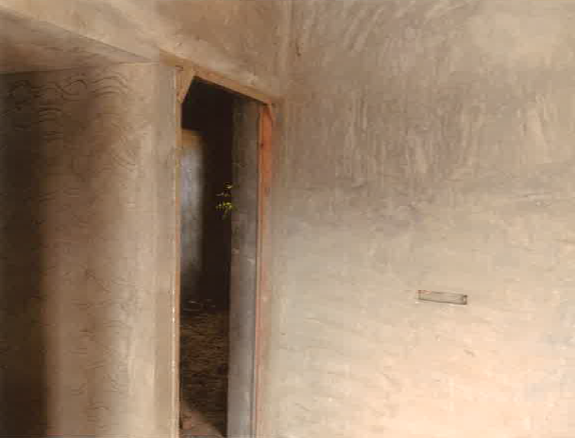
RESIDENTIAL FLAT
RESB - 059
Location of Property | MYLAPORE,THIRUVALLUR
Total area of land | 1750 sq.ft
Constructed area | 766 sq.ft ( G1,Ground Floor)
Year of construction | NA
Current market value | Rs. 05.73 Lacs

Slide 10
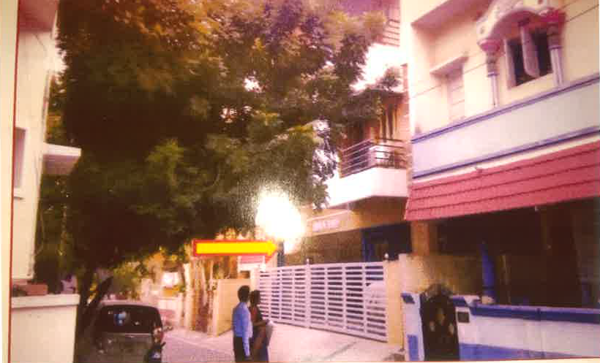
RESIDENTIAL FLAT
RESB - 060
Location of Property | KOLATHUR, CHENNAI
Total area of land | 2740 sq.ft
Constructed area | 767 sq.ft ( G1,Ground Floor)
Year of construction | 2015
Current market value | Rs. 35.00 Lacs

Slide 11
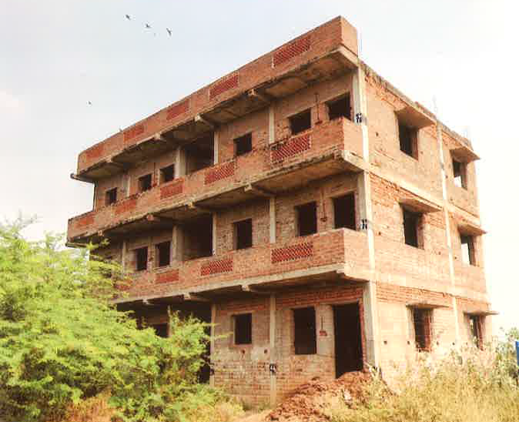
RESIDENTIAL FLAT
RESB - 061
Location of Property | MYLAPORE, THIRUVALLUR
Total area of land | 1750 sq.ft
Constructed area | 726 sq.ft ( S1,2nd Floor)
Year of construction | NA
Current market value | Rs. 05.80 Lacs

Slide 12
RESIDENTIAL FLAT
RESB - 062
Location of Property | MYLAPORE, THIRUVALLUR
Total area of land | 1750 sq.ft
Constructed area | 726 sq.ft ( F1,1ST Floor)
Year of construction | NA
Current market value | Rs. 05.80 Lacs

Slide 13
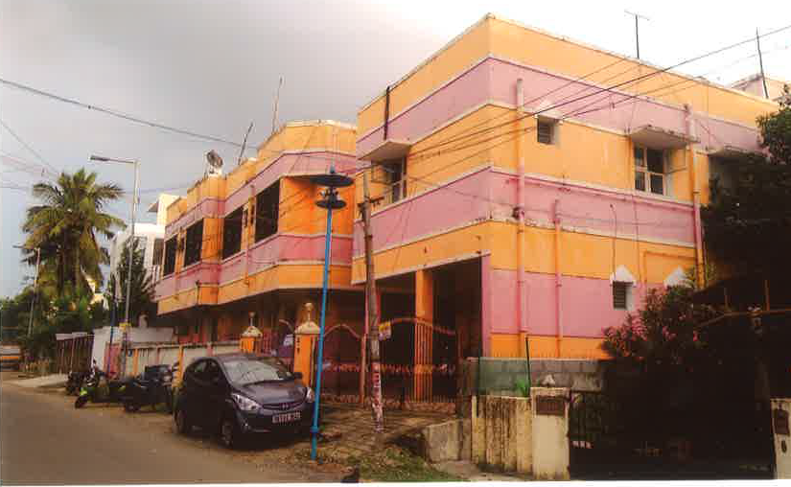
RESIDENTIAL FLAT
RESB - 063
Location of Property | AMBATTUR, CHENNAI
Total area of land | 2430 sq.ft
Constructed area | 618 sq.ft ( G-4,Ground Floor)
Year of construction | 2001
Current market value | Rs. 26.00 Lacs

Slide 14
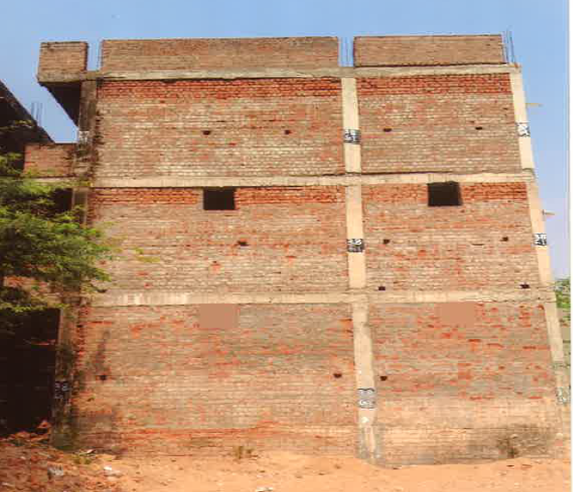
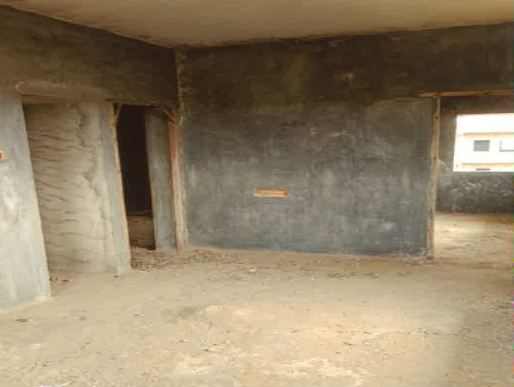
RESIDENTIAL FLAT
RESB - 064
Location of Property | MYLAPORE, THIRUVALLUR
Total area of land | 1750 sq.ft
Constructed area | 726 sq.ft ( F-2,First Floor)
Year of construction | NA
Current market value | Rs. 5.80 Lacs

Slide 15

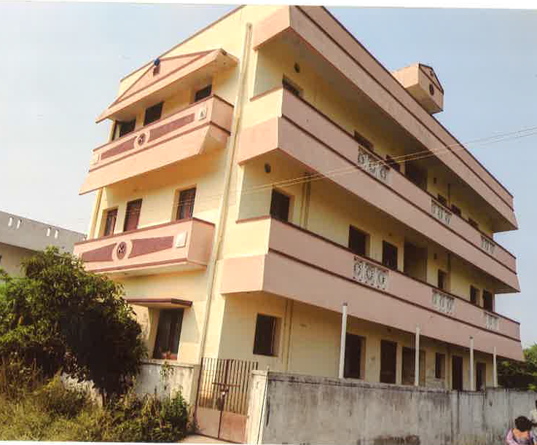
RESIDENTIAL FLAT
RESB - 065
Location of Property | SEVVAPET, THIRUVALLUR
Total area of land | 1800 sq.ft
Constructed area | 830 sq.ft ( S-2, 2nd Floor)
Year of construction | 2012
Current market value | Rs. 10.00 Lacs

Slide 16
RESIDENTIAL BUILDING
RESB - 066
Location of Property | OKKIAM THURAIPAKKAM, CHENNAI
Total area of land | 1739 sq.ft
Constructed area | Ground floor – 1739 sq.ft
Year of construction | 2011
Current market value | Rs. 56.65 lacs

Slide 17
RESIDENTIAL BUILDING
RESB - 067
Location of Property | SEVAPPET VILLAGE TIRUVALLUR DISTRICT
Total area of land | 2361 sq.ft
Constructed area | Build up – 920 sq.ft. UDS– 368sq.ft
Year of construction | 2014
Current market value | Rs. 19.09 lacs

Slide 18
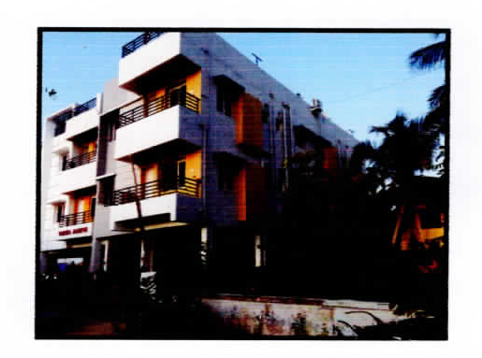
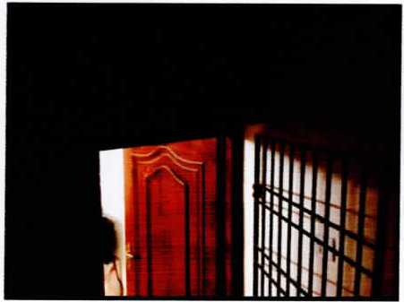
RESIDENTIAL BUILDING
RESB - 068
Location of Property | MADAMBAKKAM
Total area of land | 4969 sq.ft
Constructed area | Build up – 892 sq.ft. UDS– 403 sq.ft
Year of construction | 2017
Current market value | Rs. 35.98 lacs

Slide 19
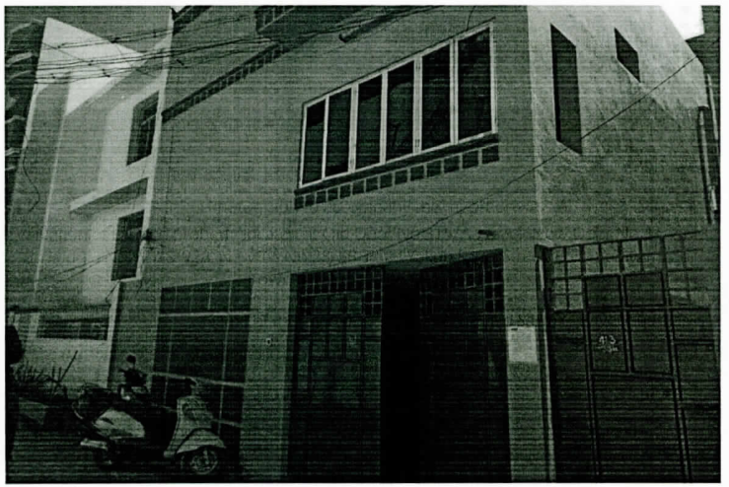
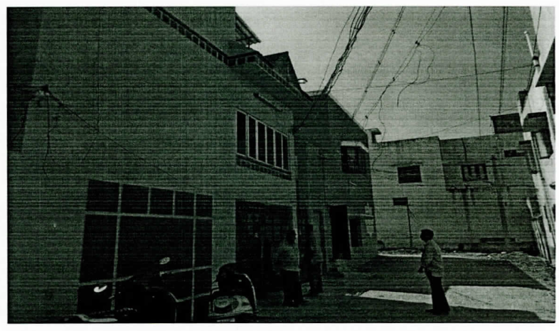
RESIDENTIAL BUILDING
RESB - 069
Location of Property | VANIYAMBADI VELLORE DISTRICT
Total area of land | 2240 sq.ft
Constructed area | Ground floor – 1760 sq.ft. (Actual), 1431 sq.ft (Plan) First floor – 1570 sq ft (Actual) 805 sq.ft (Plan)
Year of construction | 2001
Current market value | Rs. 99.40 lacs

Slide 20
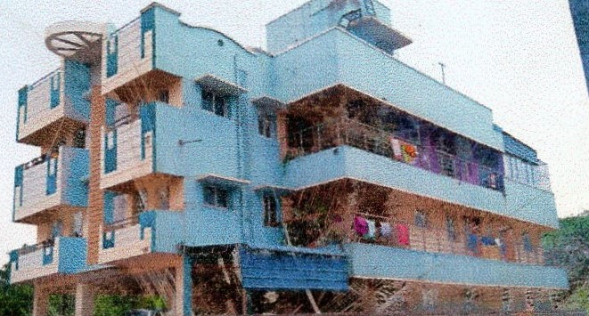
RESIDENTIAL BUILDING
RESB - 070
Location of Property | KOLAPAKKAM CHENNAI
Total area of land | 1032.50 sq.ft
Constructed area | Ground floor – 707sq.ft. First floor – 618sq.ft
Year of construction | 2012
Current market value | Rs. 41.85 lacs

Slide 21
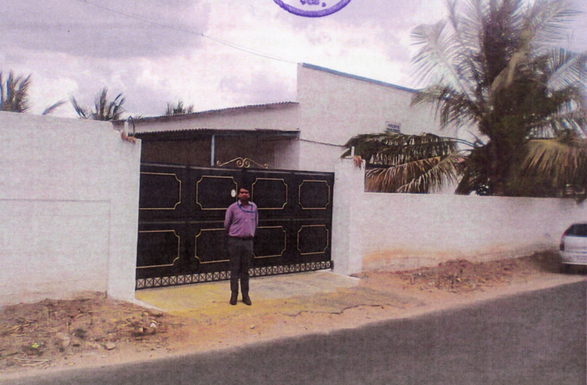
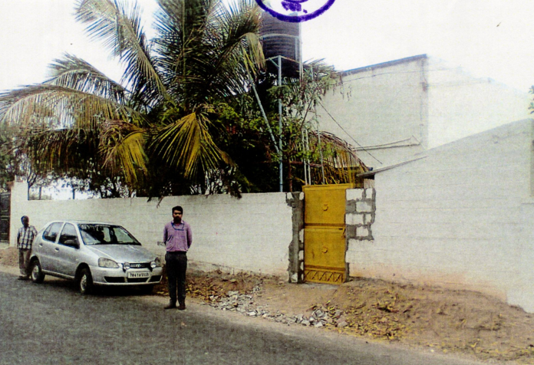
RESIDENTIAL BUILDING
RESB - 071
Location of Property | AVINASHI,TIRRUPUR
Total area of land | 1614 sq.ft
Constructed area | 800.25 sq.ft
Year of construction | 2015
Current market value | Rs. 27.15 Lacs

Slide 22
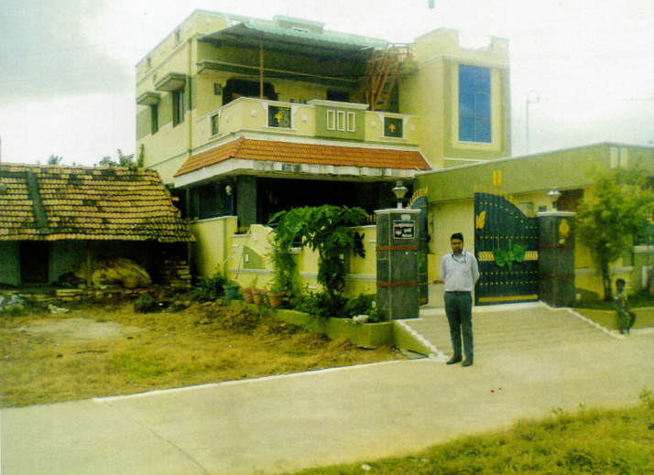

RESIDENTIAL BUILDING
RESB - 072
Location of Property | AVINASHI,TIRRUPUR
Total area of land | -----
Constructed area | ---
Year of construction | 2017
Current market value | Rs. 46.87 Lacs

Slide 23
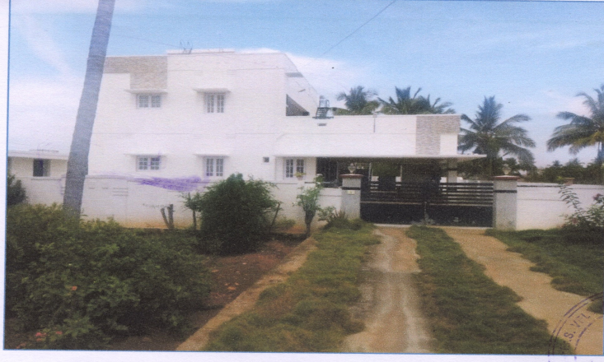
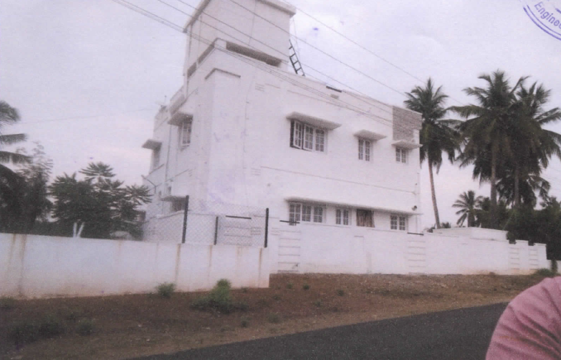
RESIDENTIAL BUILDING
RESB - 073
Location of Property | PARAMATI,NAMAKKAL
Total area of land | 6.62 Acre
Constructed area | Ground Floor 1458.44 sq.ft 1st Floor 288.75 sq.ft
Year of construction | 2006
Current market value | Rs. 109.70 Lacs

Slide 24
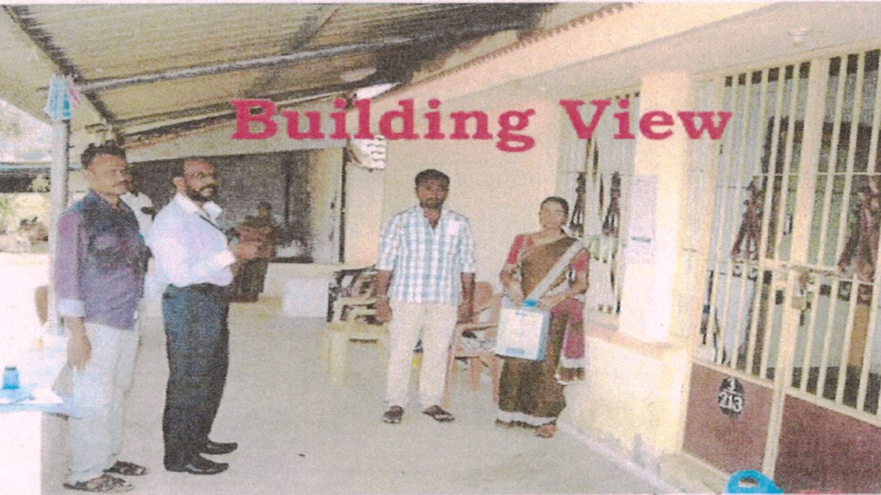
RESIDENTIAL BUILDING
RESB - 074
Location of Property | RASIPURAM,NAMAKKAL
Total area of land | 0.79 Acre
Constructed area | Residential 930.00 Godown1620sq.ft
Year of construction | 2003
Current market value | Rs. 22.00 Lacs

Slide 25
RESIDENTIAL BUILDING
RESB - 075
Location of Property | CHAMARAJAMOHALLA,MYSORE
Total area of land | 33.66 sq.mt
Constructed area | 35.72 sq.mt
Year of construction | 2003
Current market value | 14.50

Slide 26
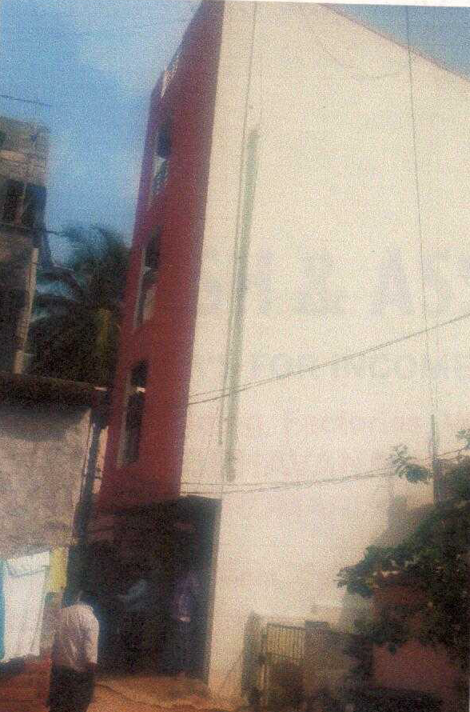
RESIDENTIAL BUILDING
RESB - 076
Location of Property | YESHWANTPUR HOBLI,BANGALORE
Total area of land | 600 sq.ft
Constructed area | 600 sq.ft
Year of construction
Current market value | 60.21 lacs

Slide 27
RESIDENTIAL BUILDING
RESB - 077
Location of Property | NAZARBAD MOHALLAH, MYSORE
Total area of land | 32.40 sq.mt
Constructed area | 18.88 sq. mt
Year of construction | 2014
Current market value | 11.20 lacs

Slide 28
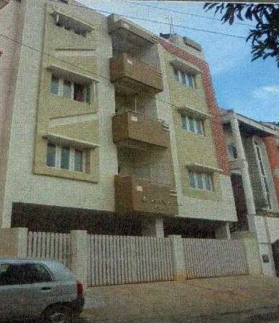
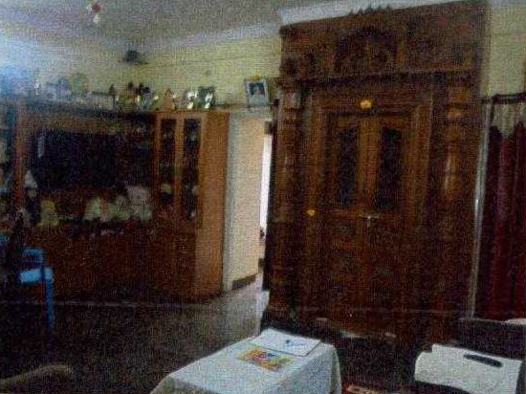
RESIDENTIAL FLAT
RESB - 078
Location of Property | UTTARAHALLI HOBLI, BANGALORE
Total area of land
Constructed area
Year of construction
Current market value | 137.73 lacs

Slide 29
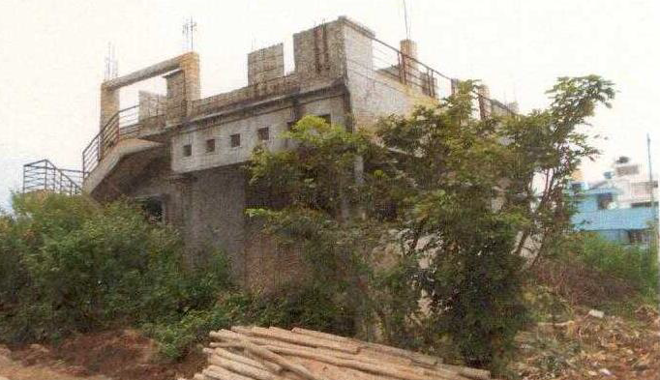
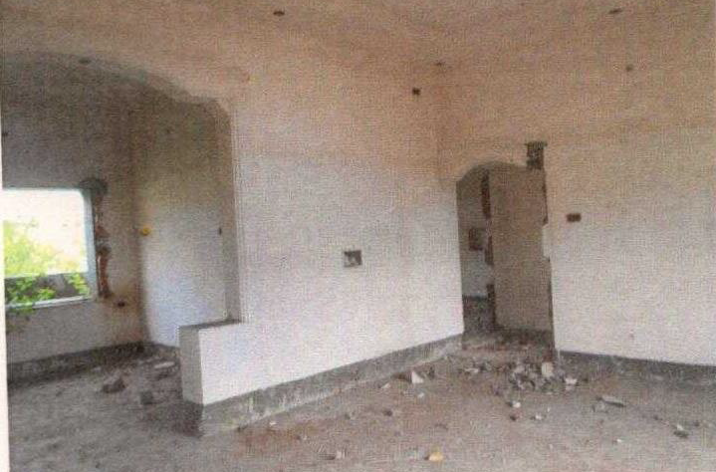
RESIDENTIAL BUILDING
RESB - 079
Location of Property | YESHVANTHAPURA HOBLI, BANGALURU
Total area of land | 1200 sq.ft
Constructed area
Year of construction
Current market value | 24.30 lacs

Slide 30
RESIDENTIAL FLAT
RESB - 080
Location of Property | NAGADEVANAHALLI, BANGALURU
Total area of land | 55.75 sq.mt
Constructed area
Year of construction
Current market value | 76.23 lacs

Slide 31
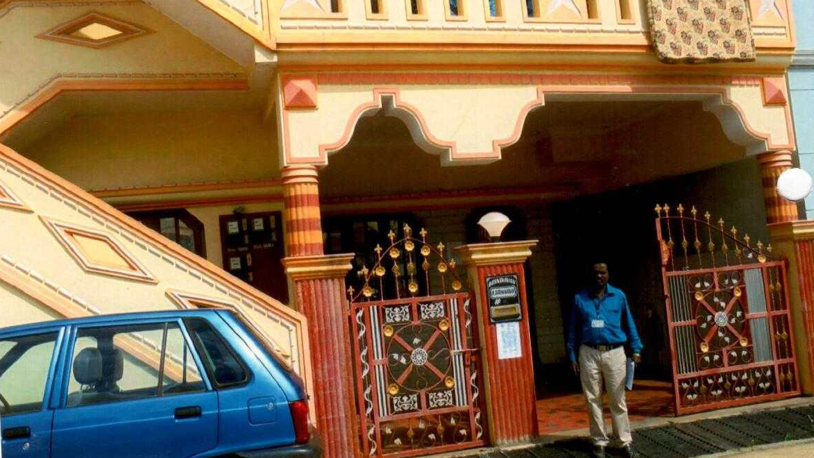
RESIDENTIAL BUILDING
RESB - 081
Location of Property | YESHVANTHAPURA HOBLI, BANGALURU
Total area of land | 1200 sq.ft
Constructed area | 1600 sq.ft
Year of construction | 2006
Current market value | 59.29 lacs

Slide 32
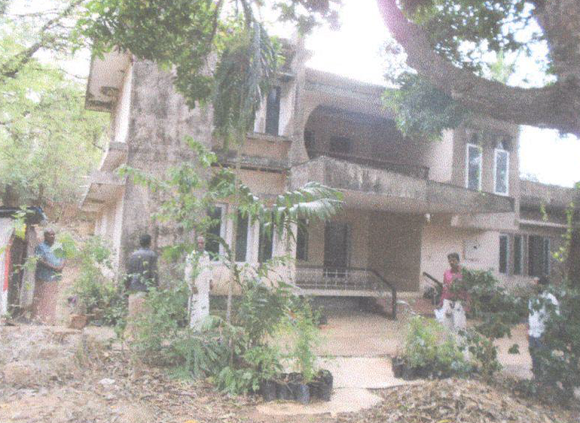
RESIDENTIAL BUILDING
RESB - 082
Location of Property | THALASSERY, KANNUR
Total area of land | 15 cents
Constructed area | 2000 sq.ft
Year of construction | 1984
Current market value | 121.94 lacs

Slide 33
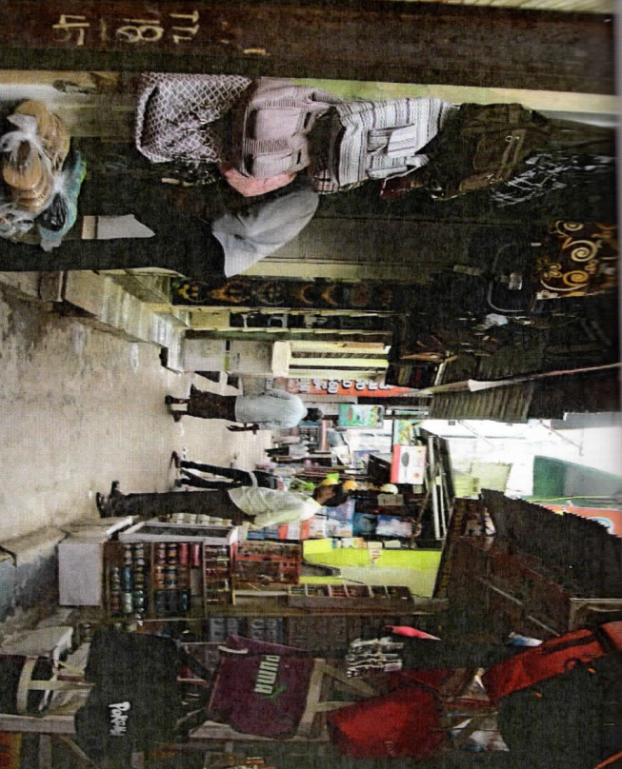
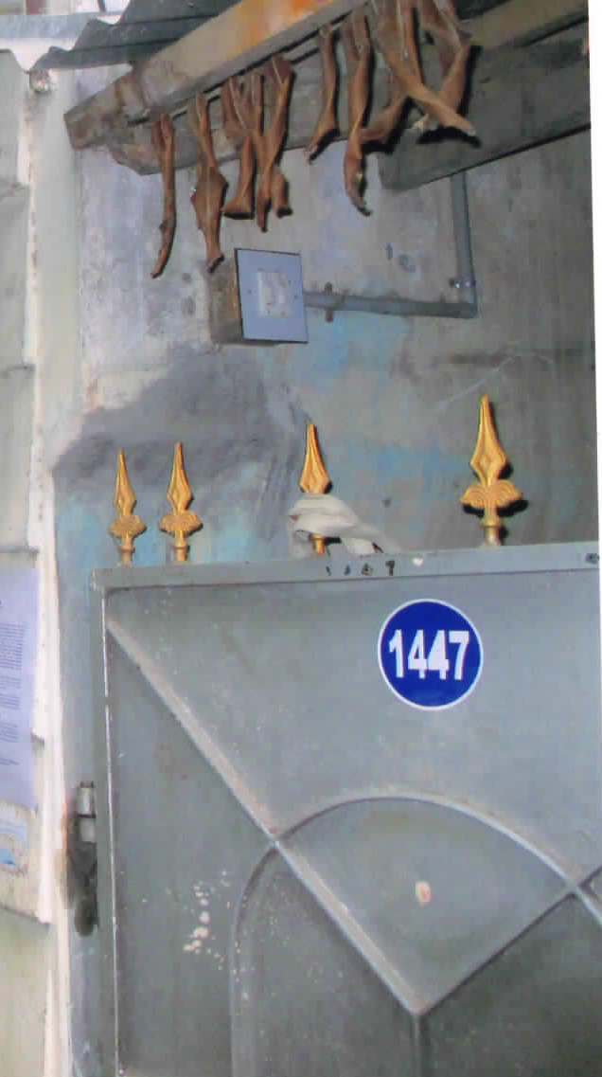
RESIDENTIAL HOUSE PROPERTY
RESB - 083
Location of Property | South Main Street, Thanjavur
Total area of land | 1817. sq.ft
Constructed area | Ground floor 1260 sq ft First floor– 1260 sq.ft
Year of construction
Current market value | Rs. 82.00 lacs

Slide 34
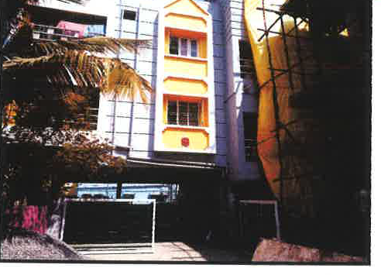
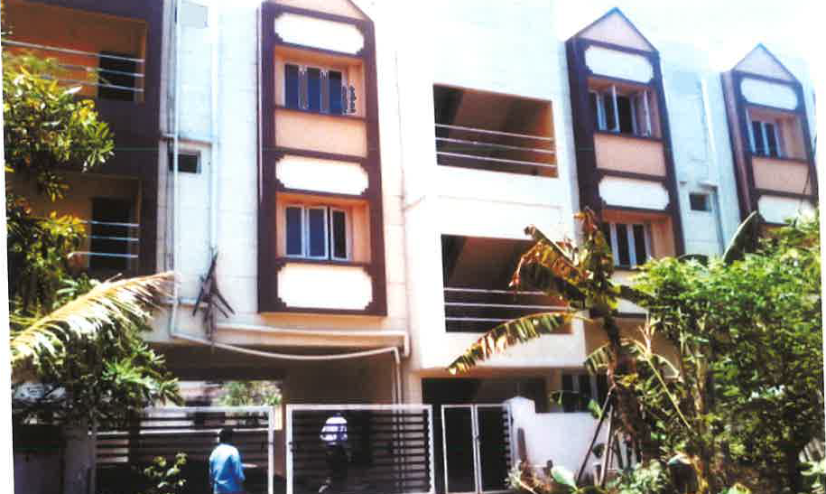
RESIDENTIAL FLAT
RESB - 084
Location of Property | MADIPAKKAM RAM NAGAR CHENNAI
Total area of land | 4608. sq.ft
Constructed area | First floor– 1080 sq.ft
Year of construction | 2010
Current market value | Rs. 47.35 lacs

Slide 35
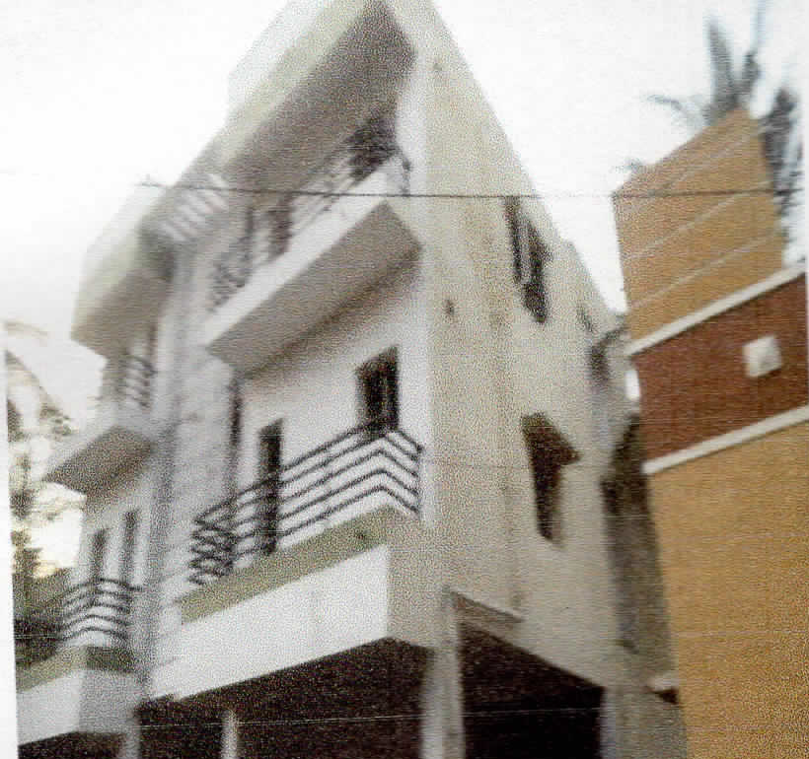
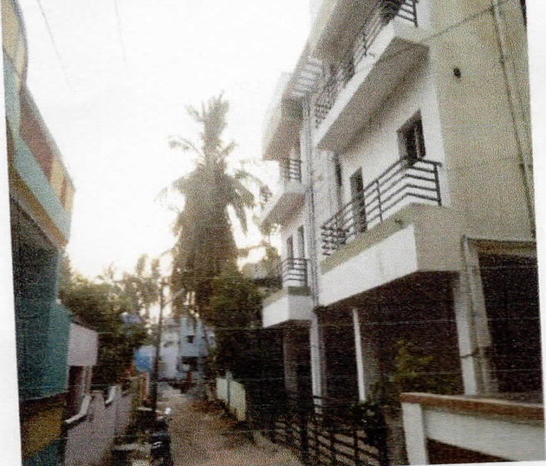
RESIDENTIAL FLAT mahendran
RESB - 085
Location of Property | Thiruvengada nagar thiruninravur village
Total area of land | 2400. sq.ft
Constructed area | Second floor– 1372sqft with 677 sqft UDS
Year of construction | 2015
Current market value | Rs. 45.61 lakhs

Slide 36
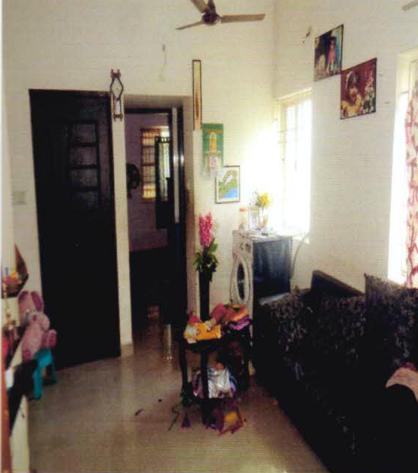
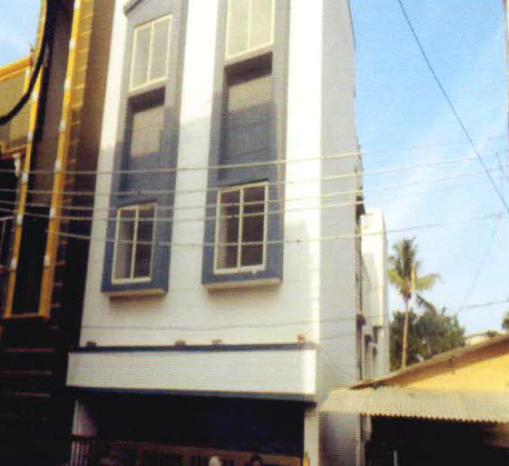
RESIDENTIAL FLAT
RESB - 086
Location of Property | RAMANAJUR STREET KOLATHUR CHENNAI
Total area of land | 1355. sq.ft
Constructed area | FIRST FLOOR – 661 sq.ft. ft
Year of construction | 2014
Current market value | Rs. 31.39 lacs

Slide 37
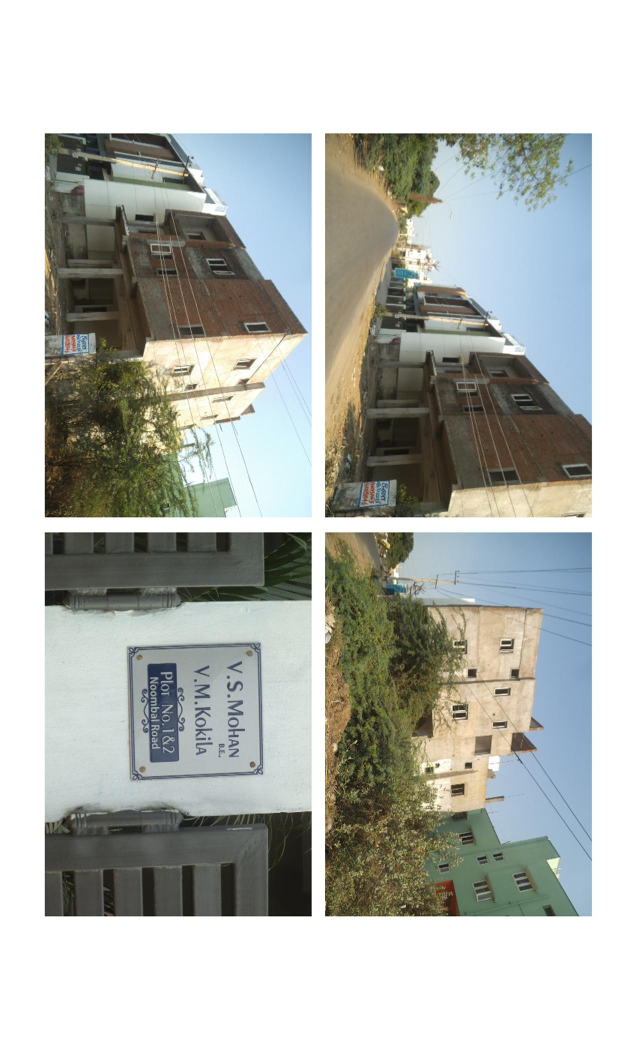
RESIDENTIAL BUILDING
RESB - 087
Location of Property | CHENNAI , NOMBAL AMBATTUR
Total area of land | 2310 SQ FT
Constructed area | FIRST FLOOR 910 sq.ft- uds 410 sq.ft
Year of construction | UNDER CONSTRUCTION
Current market value | Rs. 29.00 lacs

Slide 38
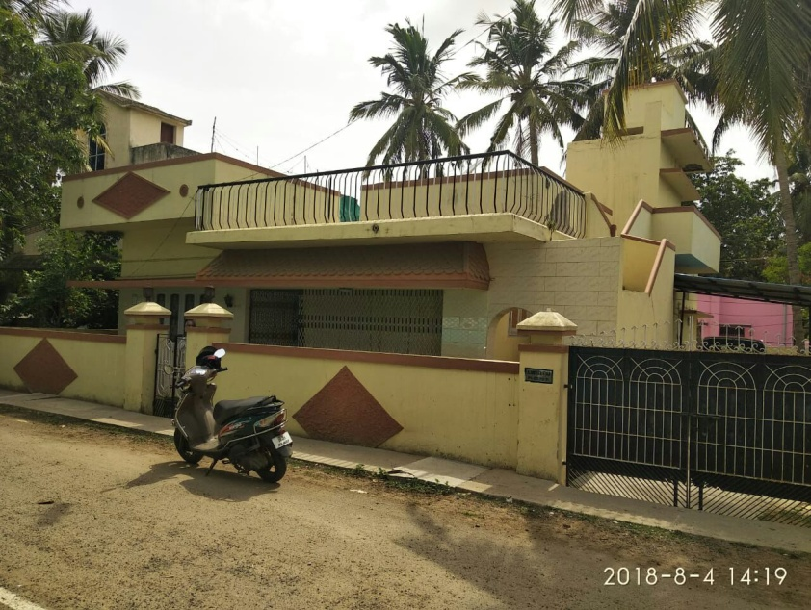
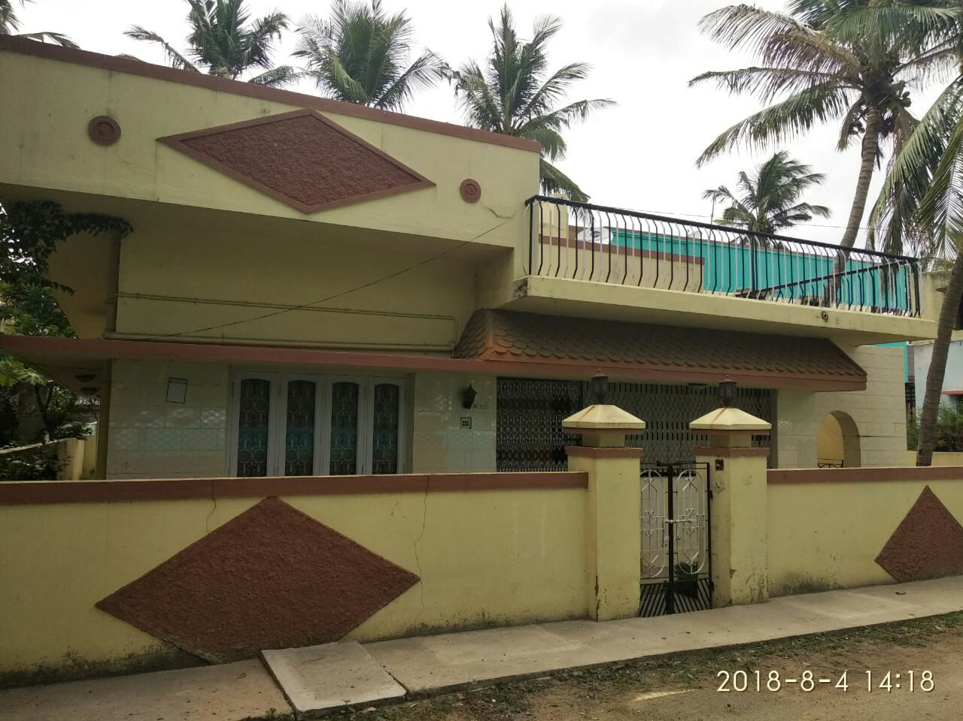
RESIDENTIAL BUILDING
RESB - 088
Location of Property | CHENNAI AVADI
Total area of land | 3381. sq.ft
Constructed area | Ground floor – 1885 sq.ft. First floor –120 sq.ft (AS PER PLAN 964 SQ. FT.)
Year of construction | 2012
Current market value | Rs. 73.00 lacs

Slide 39
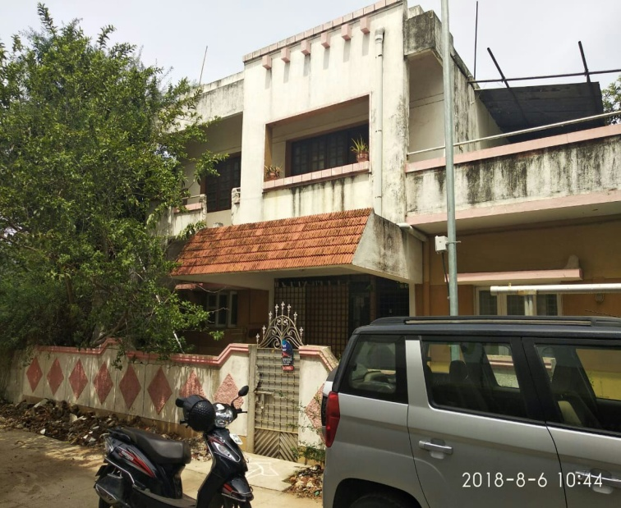
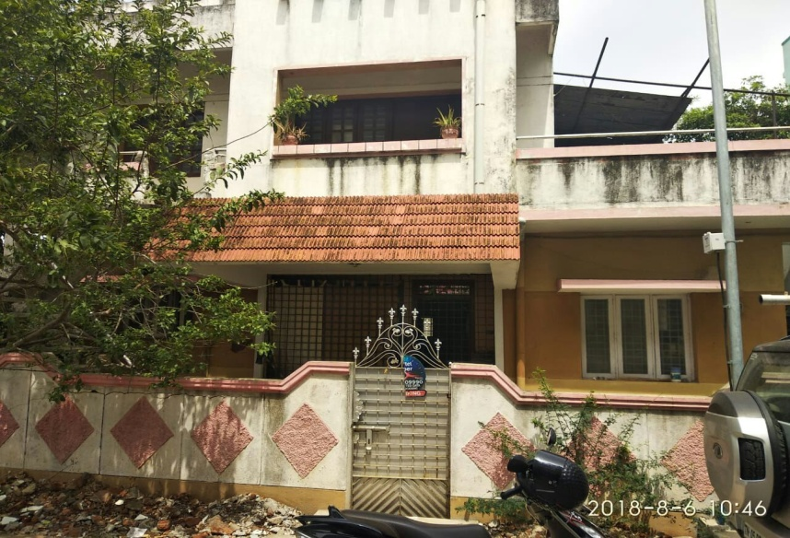
RESIDENTIAL BUILDING
RESB - 089
Location of Property | CHENNAI ,SATYA NAGAR KOLATHUR
Total area of land | 1040. sq.ft
Constructed area | GF 989 sq.ft., FF 749 sq.ft
Year of construction | 2001
Current market value | Rs. 123.00 lacs

Slide 40


RESIDENTIAL BUILDING
RESB - 090
Location of Property | MAHA LAKSHMI NAGAR , MADIPAKKAM
Total area of land | 2400. sq.ft
Constructed area | 2570 sq.ft
Year of construction | 2001
Current market value | Rs. 143.00 lacs

Slide 41

RESIDENTIAL BUILDING
RESB - 091
Location of Property | CUDDALORE
Total area of land | 3150 sq.ft
Constructed area | ----
Year of construction | 2009
Current market value | Rs.11.55 Lacs

Slide 42


RESIDENTIAL BUILDING
RESIDENTIAL BUILDING
RESB - 092
Location of Property | CHENGALPATTU,KANCHIPURAM
Total area of land | 2328.25 sq.ft
Constructed area | Ground Floor 594 sq.ft
Year of construction | 2008
Current market value | Rs. 18.53 lacs

Slide 43


RESIDENTIAL BUILDING
RESIDENTIAL BUILDING
RESB - 093
Location of Property | KANCHIPURAM
Total area of land | 2362.00 sq.ft
Constructed area | ------
Year of construction | 2008
Current market value | Rs. 23.60 lacs

Slide 44

RESIDENTIAL BUILDING
RESB - 094
Location of Property | AVADI, CHENNAI
Total area of land | 840 Sq.ft.
Constructed area | 486.62 Sq.ft. each(GF+FF)
Year of construction | 2015
Current market value | Rs. 53.29 lacs

Slide 45
RESIDENTIAL FLAT
RESB - 095
Location of Property | TAMBARAM, CHENNAI
Total area of land | 341 sq.ft(UDS)
Constructed area | 784 sq.ft(Flat no.A,FF)
Year of construction | 2015
Current market value | Rs. 25.32 lacs

Slide 46


RESIDENTIAL BUILDING
RESB - 096
Location of Property | KUMBAKONAM
Total area of land | 1600 sq.ft
Constructed area | 1094 sq.ft
Year of construction | 2013
Current market value | Rs. 51.72 Lacs

Slide 47

RESIDENTIAL BUILDING
RESB - 097
Location of Property | KUMBAKONAM
Total area of land | 8720 sq.ft
Constructed area | 662 sq.ft
Year of construction | 2010
Current market value | Rs. 10.36 Lacs

Slide 48


RESIDENTIAL BUILDING
RESB - 098
Location of Property | CUDDALORE
Total area of land | 1498.50 sq.ft
Constructed area | 1034 sq.ft
Year of construction | 2012
Current market value | Rs. 29.03 Lacs

Slide 49

RESIDENTIAL BUILDING
RESB - 099
Location of Property | CUDDALORE
Total area of land | 1744 sq.ft
Constructed area | 1034 sq.ft
Year of construction | 2014
Current market value | Rs. 10.08 Lacs

Slide 50

RESIDENTIAL BUILDING
RESB - 100
Location of Property | TIRUPUR
Total area of land | 2000 sq.ft
Constructed area | 934 sq.ft
Year of construction | 2014
Current market value | Rs. 15.00 Lacs

